Slide 1
Team Management and Managerial Decision Making
DAY-(3)

Slide 2
PROGRESS TILL NOW……
Team-Management Concept
Break-Down Structure
Kottler’s distinction between MANAGERS and LEADERS
TEAM DEVELOPMENT MODEL
Barriers
Group Intercommunication Formula
Stephen Covey's Habits
All about Leadership(Features, Factors,Theories,Styles etc)

Slide 3
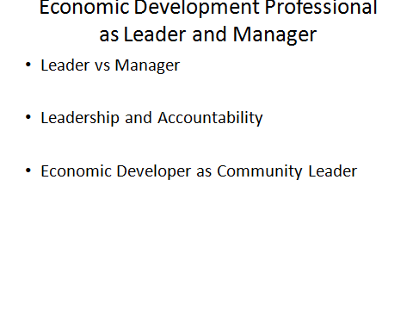

Slide 4
What keeps us awake at night?
• What drives us to do the very best we know how? • If we could create our ideal organization [community], what would it look like?
• What are the qualities that would make our organization [community] a great place to work [and live]?
• How would we describe the kind of organization [or community] that makes us say, “I can’t wait to go there?”
• What is unique about our hopes, dreams and aspirations?
• What images come to mind when thinking about the future? What does it look like, sound like, taste like, and feel like?
• How does our vision serve the common good?

Slide 5
THEORIES
CONTINGENCY THEORY
PARTICIPATIVE THEORY
BEHAVIOURAL THEORY

Slide 6
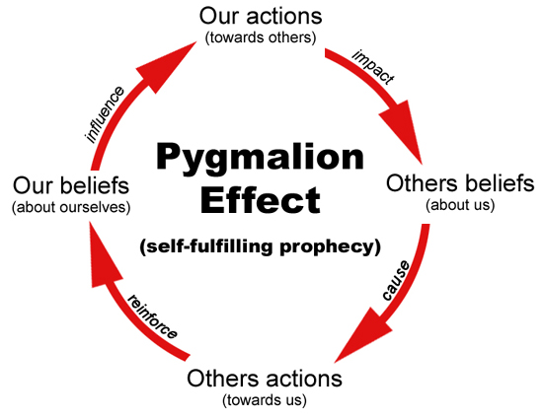
BOOK
McGregor THEORY of X AND Y+ THEORY Z

Slide 7
CONFLICT MANAGEMENT
What is conflict management?
Views of Conflict
Types of Conflict
Causes of Conflict
Principles of Conflict Resolution
Resolving Workplace Conflict
Functional and Dys-Functional Conflict
Positive outcomes of Conflict
Questions
Conflict Resolution

Slide 8
What is Conflict?
Conflict is a natural ingredient not only in organization, but also in every places.
Expressed struggle between at least two interdependent parties.

Slide 9


Slide 10
VIEWS OF CONFLICT
Traditional View of Organizational Conflict
Human Relations View of Organizational Conflict
Interactionist View of Organizational Conflict

Slide 11
DIFFERENCE
The traditional view of organizational conflict | Current view of organizational conflict
Conflict is avoidable. | Conflict is inevitable.
Conflict is caused by management error in designing organizations or by trouble makers. | Conflict arises from many causes, including organizational structure, unavoidable differences in goals, differences in perceptions and values of specialized personnel and so on.
Conflict disrupts the organization and prevents optimal performance. | Conflict contributes and detracts from organizational performance in varying degrees.
The task of the management is to eliminate conflict. | The task of the management is to manage the level of conflict and its resolution for optimal organizational performance.
Optimal organizational performance requires the removal of conflict. | Optimal organizational performance requires a moderate level of conflict.

Slide 12
TYPES OF CONFLICT
Relationship Conflicts
Data Conflicts
Interest Conflicts
Structural Conflicts
Approach-approach conflict
Approach-avoidance conflict
Avoidance-avoidance conflict
Value Conflicts

Slide 13

RELATIONSHIP CONFLICT

Slide 14
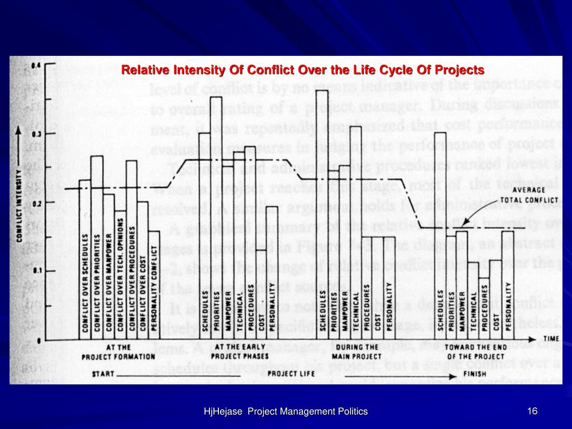
DATA CONFLICT

Slide 15
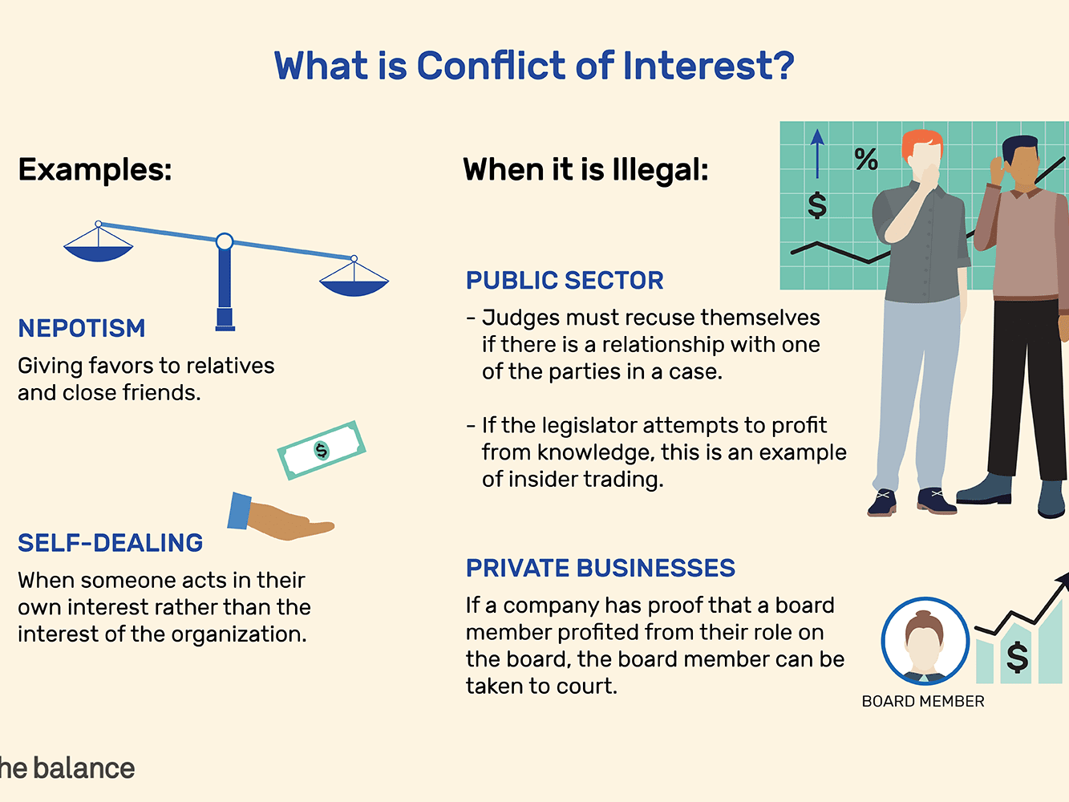
INTEREST CONFLICT

Slide 16
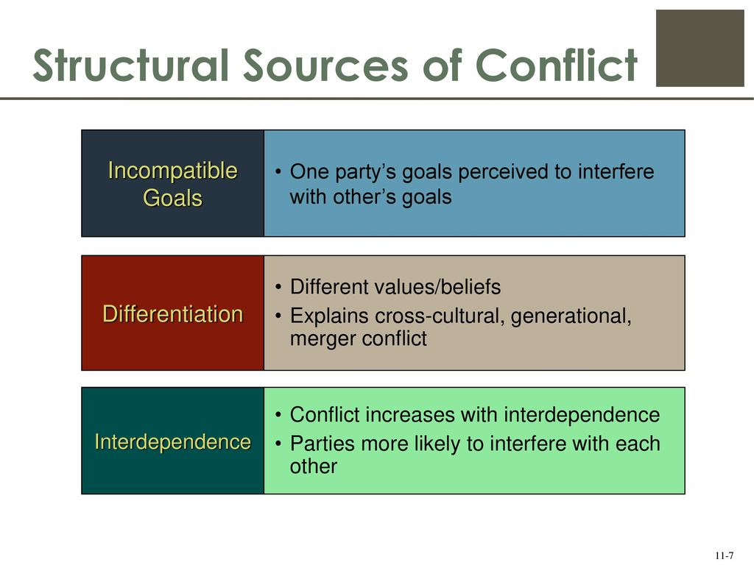
STRUCTURAL CONFLICT

Slide 17
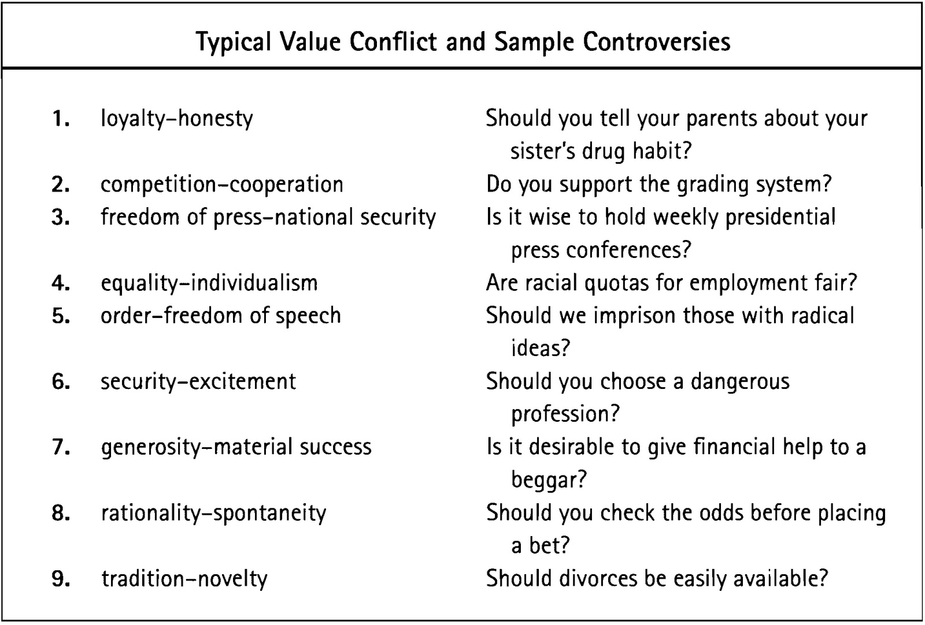
VALUE CONFLLICT

Slide 18

CONFLICT-VIDEO

Slide 19
CAUSES OF CONFLICT
…….. arising from the differences
………arising from the needs

Slide 20
PRINCIPLES OF CONFLICT RESOLUTION
Being Calm
Being magnanimous
Need for discussion
Rational Application
Acknowledge emotions
Allow creative thoughts
Changing of ambience
Compromisation
Acceptance

Slide 21
RESOLVING WORPLACE CONFLICT
Good self-control
Patient listener
To have a GIVE and TAKE attitude
THE LEVELS OF CONFLICT : WORKPLACE

Slide 22
FUNCTIONAL and DYSFUNCTIONAL CONFLICT
FUNCTIONAL : works towards the organization or the group.
DYSFUNCTIONAL : blocks an organization from reaching its goal.

Slide 23
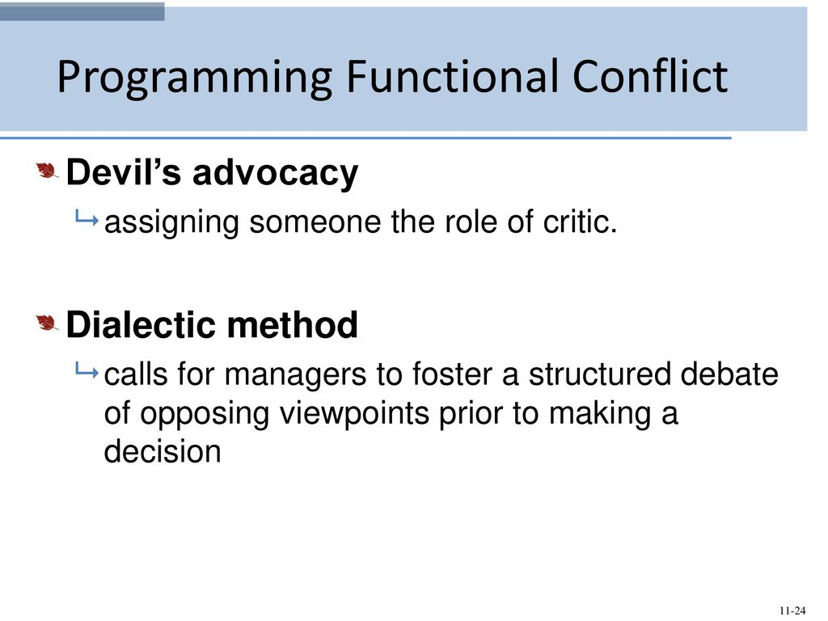

Slide 24
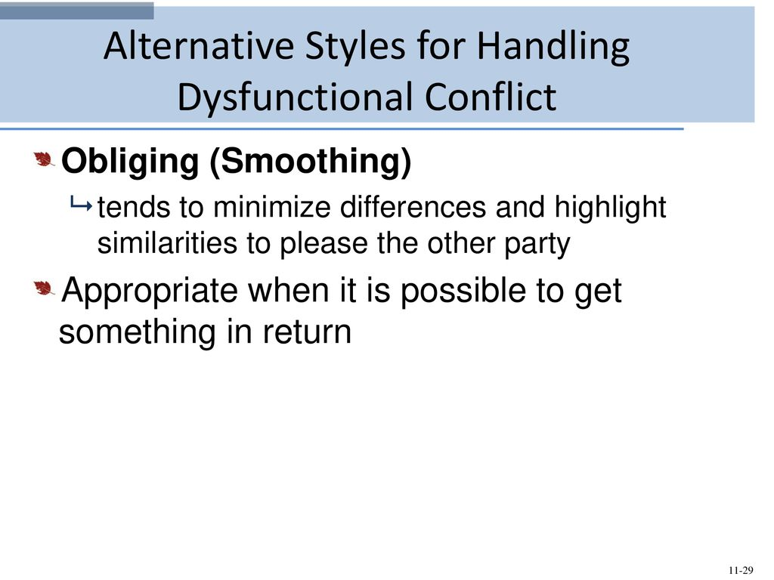

Slide 25
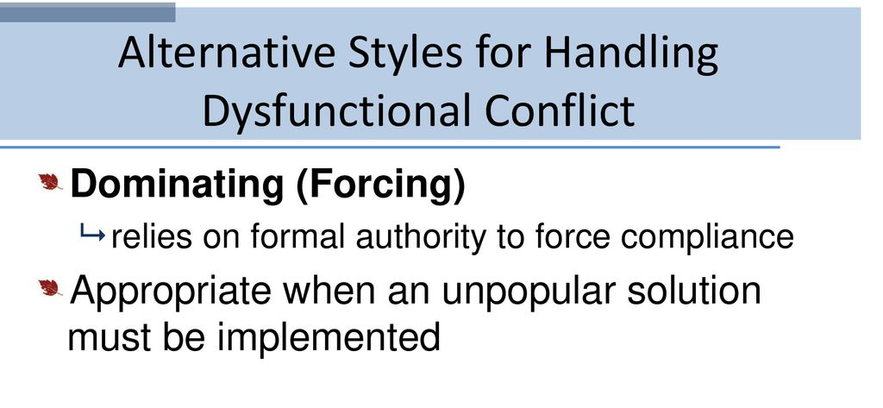

Slide 26
Positive Outcome of Conflicts
Provide great interest in topic of discussion
Stimulate greater feelings of identity
Draw attention to the existing problems
Promote understanding
Motivate to work ( already discussed on DAY-2 )

Slide 27
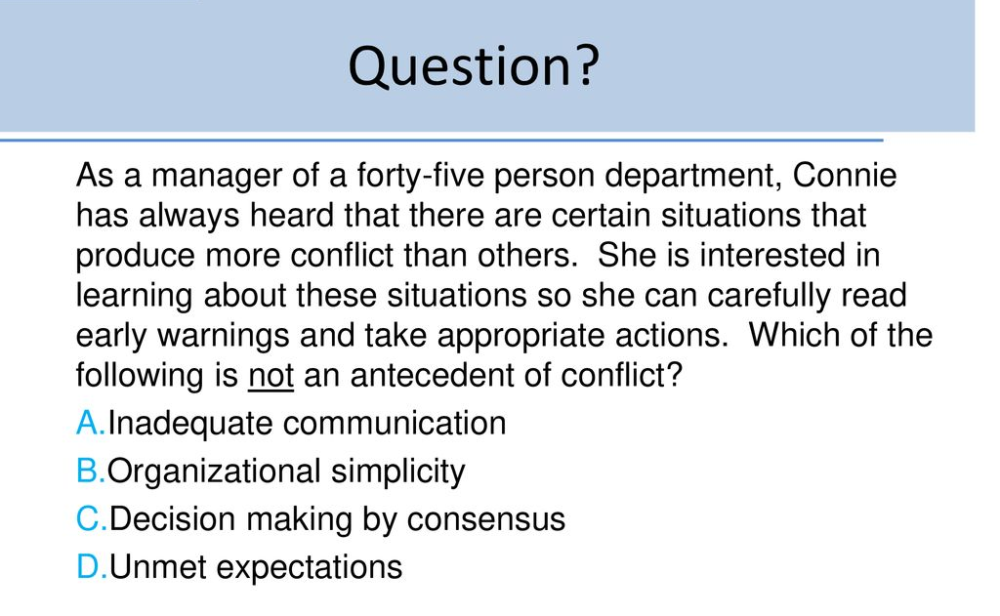

Slide 28
CONFLICT RESOLUTION
Get in touch with your feelings
Hone your listening skills
Practice assertive communication
Seek a solution
Know when it’s not working

Slide 29
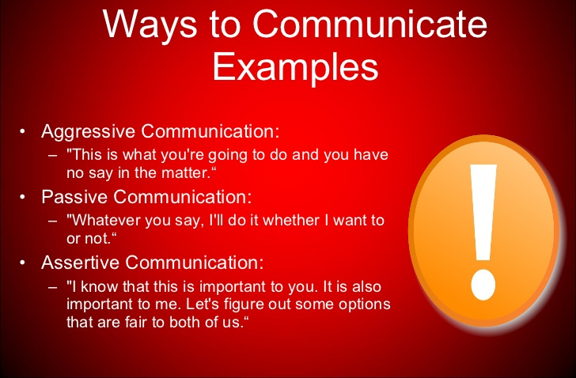
ASSERTIVE COMMUNICATION

Slide 30
CONFLICT CONTINUUM
I win, you lose -COMPETITION
I lose or give in-ACCOMMODATION
We both get something-COMPROMISE
We both “win”- COLLABORATE
I would like to avoid - AVOIDANCE

Slide 31


Slide 32


Slide 33


